Slide 1

U.S. & California
COVID-19
Jaclyn Coate
Josh Eysenbach
Project: EDA
Summer 2020 Time Series 6373
Notes:
I’m Jaclyn Coate. Josh Eysenbach and I are here to present a quick overview of our initial COVID analysis for the US and California.

Slide 2

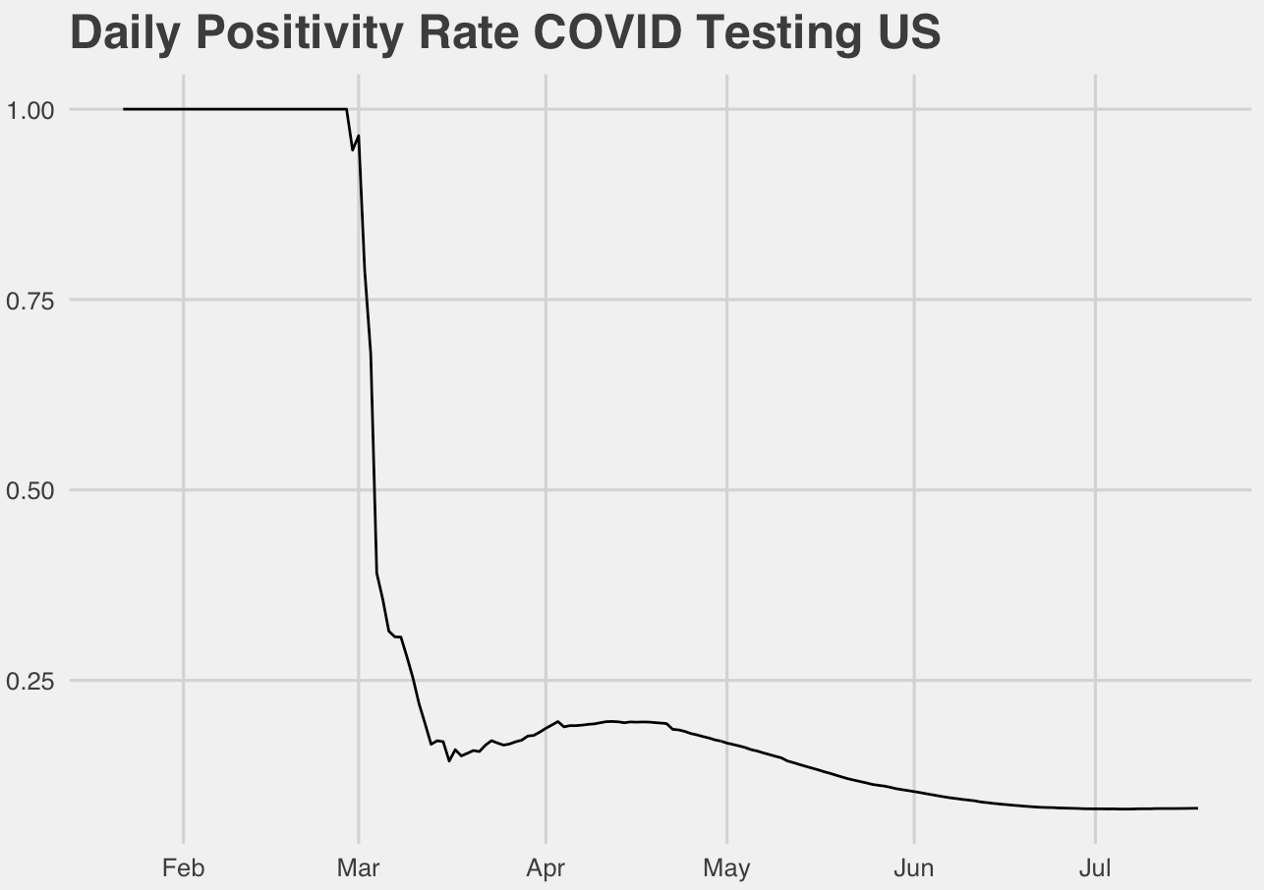
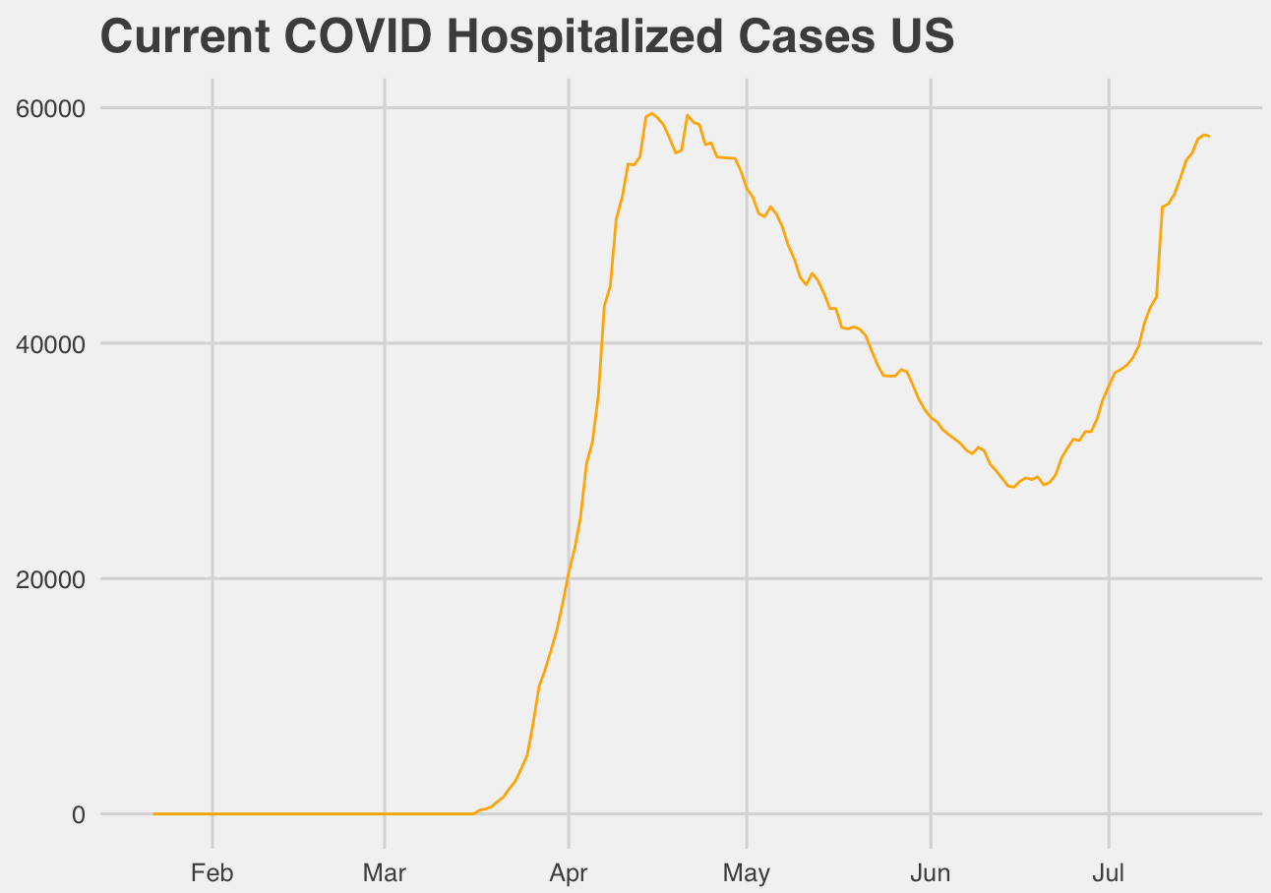
Overview
Presenters
Josh Eysenbach
Jaclyn Coate
Data Set
The COVID Tracking Project
California data: ca.gov
Severity Measurement
Positive Percent
Death Rate
Currently Hospitalized
Notes:
We have spent the last week reviewing data sets to build useful models for prediction of COVID severity. Our data set used is The COVID Tracking Project, it is built from official state and federal data collections, as well as used by many trusted groups such as the CDC and Johns Hopkins. We believe this is the best data source at this time.
Josh 30 sec
Positive percent is a stat appearing more recently that normalizes the growing number of COVID cases by dividing them by the total number of tests, but we wanted to choose a variable that best represents what we should use to make decisions. Studies have shown anywhere from 40-80% of people are asymptomatic. We think the count of Hospitalized COVID patients is a better representation of the current impact on the community if we assume the amount of testing is independent of people showing symptoms. After all, the original driving force to “flatten the curve” was out of concern that our hospitals would be overrun, so it makes sense to use this to model the problem.

Slide 3
Overview
Presenters
Josh Eysenbach
Jaclyn Coate
Data Set
The COVID Tracking Project
California data: ca.gov
Severity Measurement
Positive Percent
Death Rate
Currently Hospitalized
Notes:
Positive percent is a stat appearing more recently that normalizes the growing number of COVID cases by dividing them by the total number of tests, but we wanted to choose a variable that best represents what we should use to make decisions. Studies have shown anywhere from 40-80% of people are asymptomatic. We think the count of Hospitalized COVID patients is a better representation of the current impact on the community if we assume the amount of testing is independent of people showing symptoms. After all, the original driving force to “flatten the curve” was out of concern that our hospitals would be overrun, so it makes sense to use this to model the problem.

Slide 4
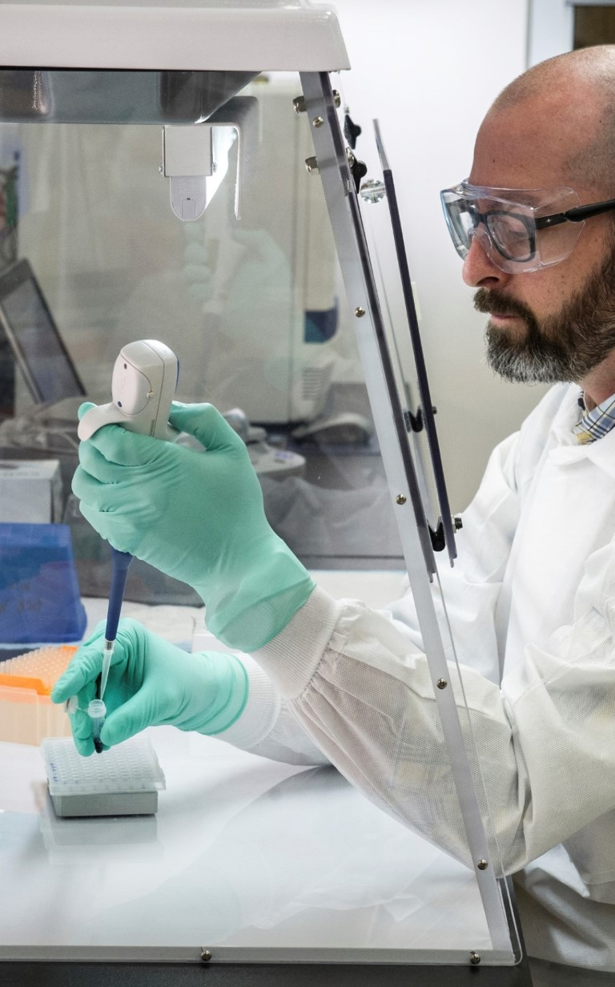
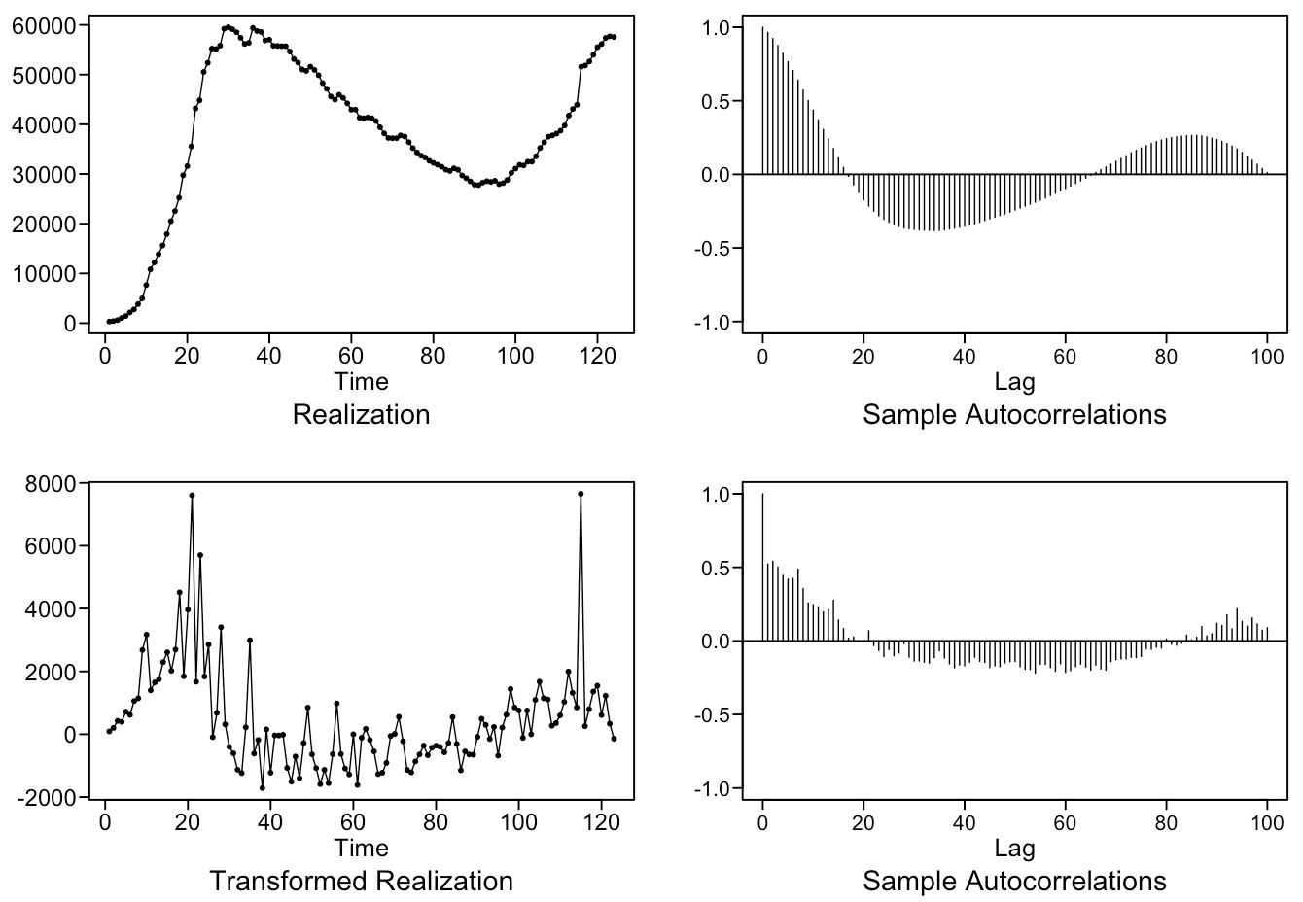
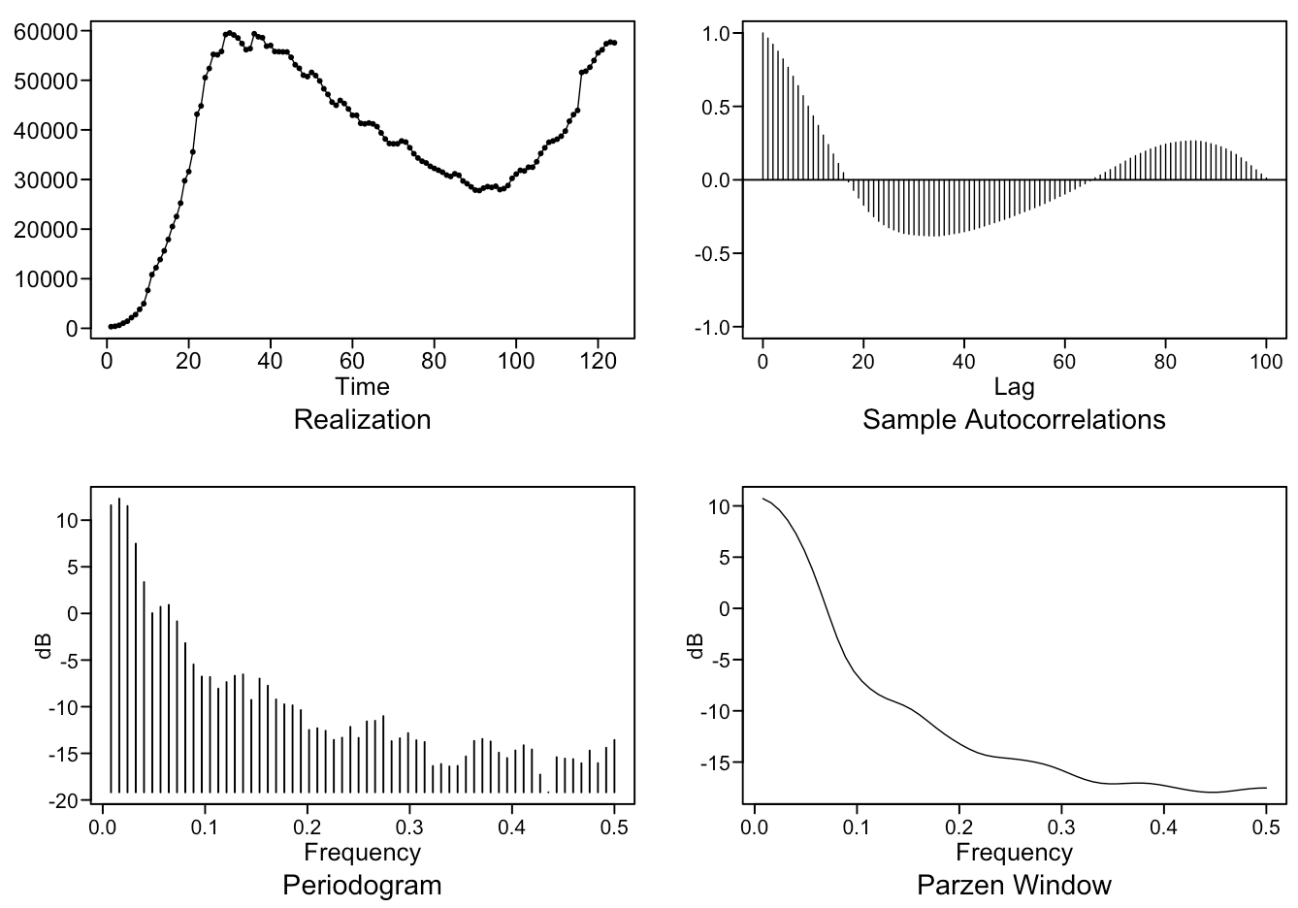
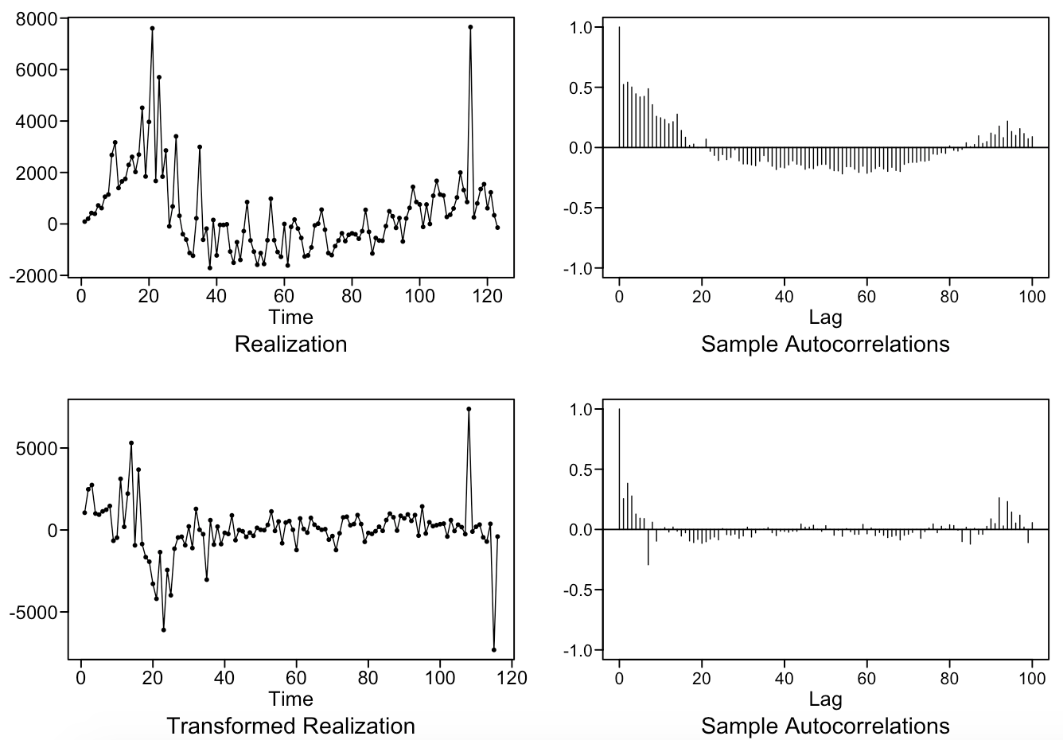
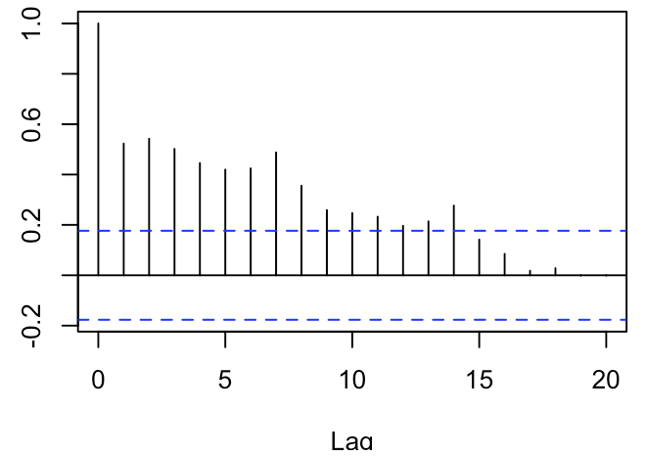
United States
Stationary v Non-stationary
Realization
heavy wandering
ACF
slowly damping
pos and neg correlation ?
Spectral Densities
frequency = 0
slight wave feature
Difference and Transformation
Notes:
We’ll examine the US data first:
**We are working under the assumption COVID is a novel virus and cases, as well as hospitalizations, will return to zero. This assumption means we are working with non-stationary data.
When reviewing the initial data, we see heavy wandering patterns and small pseudo-cyclic behavior in our realization.
The ACF shows slowly dampening behavior consistent with a d=1 ARIMA model.
It also shows highly correlated data, we know it can’t maintain that correlation due to the nature of a novel virus.
The spectral density has a peak at f=0.
As well as a small wave through the rest of the graph line.
This could be a seasonality or frequency component hidden by the heavy wandering behavior in the realization above.
**Single Difference of Data: 12 seconds
We performed a single data difference and now observe what looks much closer to a stationary data set. However, we surfaced a seasonality component, specifically we see the ACF having peaks at 7 and 14.
**Seasonal Transformation of 7 days: 11 seconds
We performed a seasonality transformation of 7 and see that the finale realization has a strong stationary appearance. As well as an ACF that is reflective of data we can model, that is not white noise.

Slide 5

United states
ARMA Candidate Models
ARMA(5, 1)
AIC: 14.5898
AR(2)
AIC: 14.6598
Model Equations
ARIMA(5,1,1), s = 7
(1+.6073B-.5494B²-.5896B³-.0396B⁴+.3023B⁵)(1-B⁷)(1-B)(X_{t}+37955.28)= a_{t}
ARIMA(2,1,0), s = 7
(1-.1531B-.4183B²)(1-B⁷)(1-B)(X_{t}+37955.28)= a_{t}
Notes:
We diagnosed our stationary data and were able to determine an ARMA(5,1) and AR(2) were the best models. With their AICs nearly identical we tested these two models against each other using a windowed ASEs for the short and long term forecasts.

Slide 6

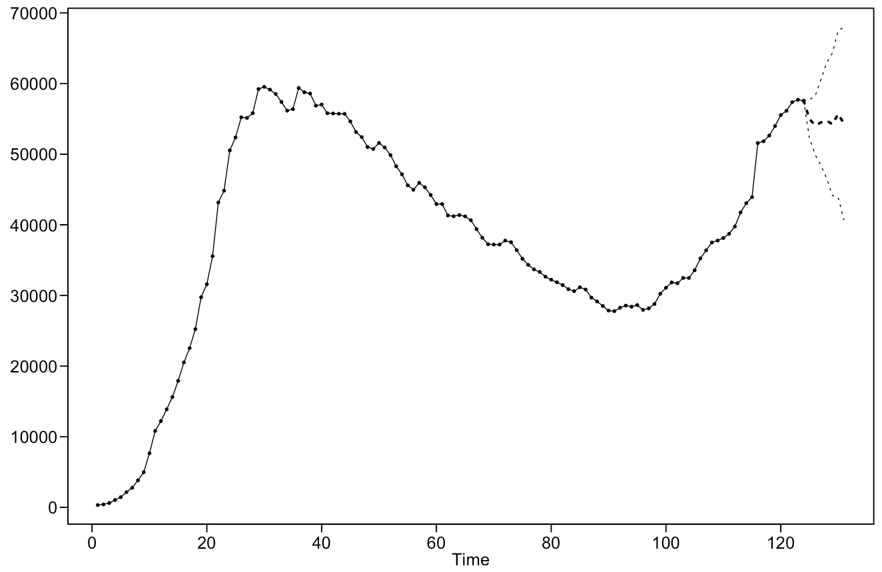
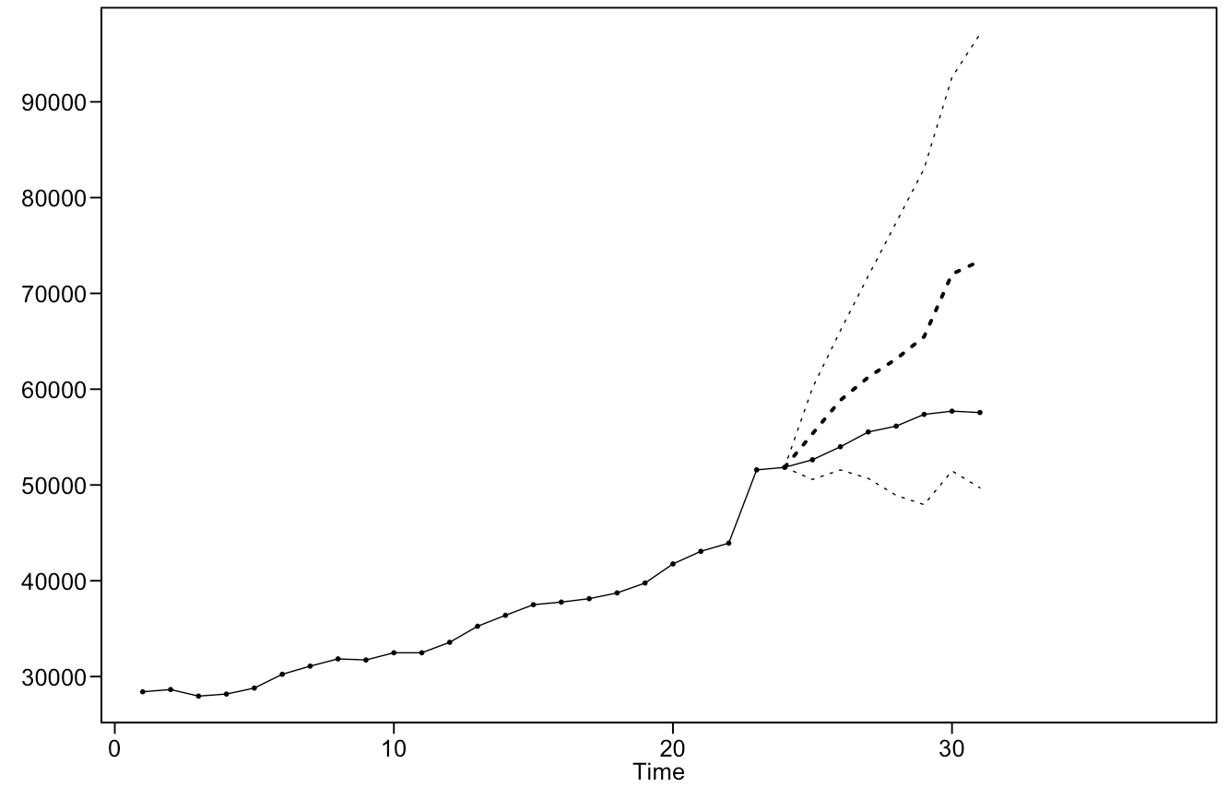
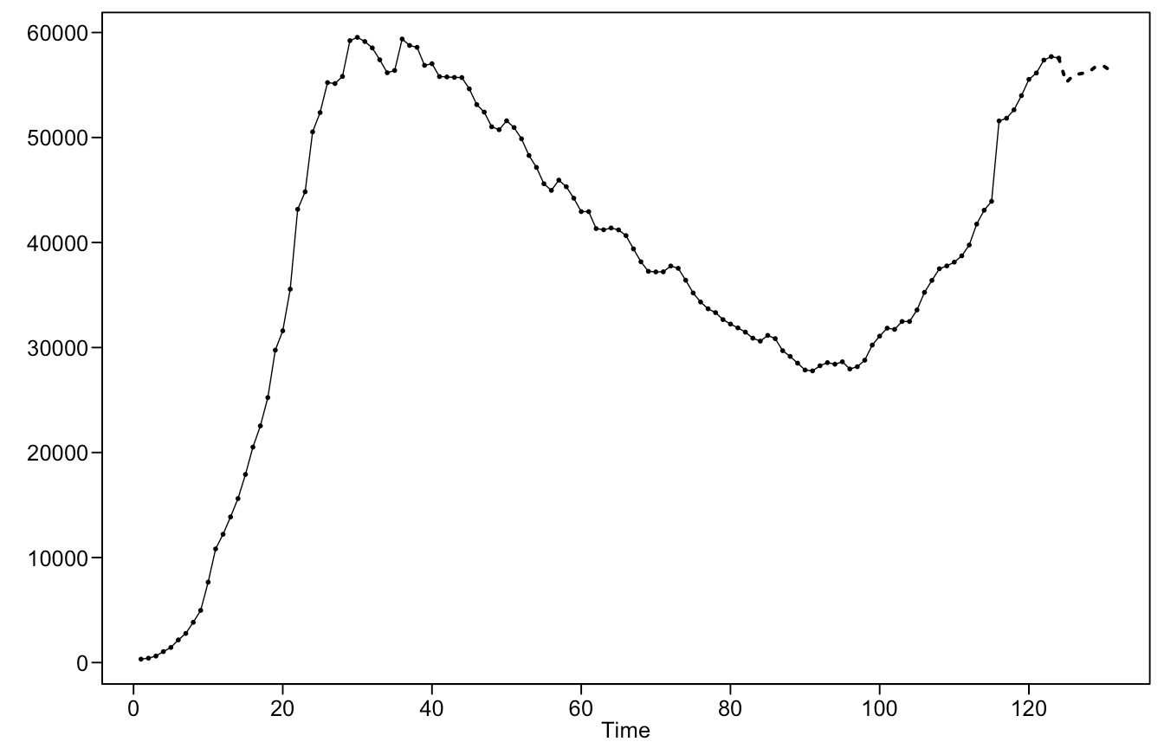
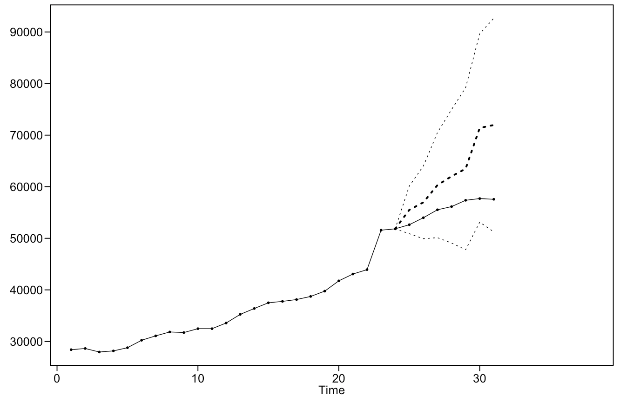
United states
7 Day Forecast
ARIMA(5, 1, 1), s = 7
Windowed ASE: 262,139,992
ARIMA(2, 1, 0), s = 7
Windowed ASE: 303,009,042
Notes:
7 Day Forecast:
The 7 day forecasts for both models continue the trend with a small 7 day seasonality pattern.
The ARIMA(5,1,1) model is a more adequate model with a smaller windowed ASE.

Slide 7

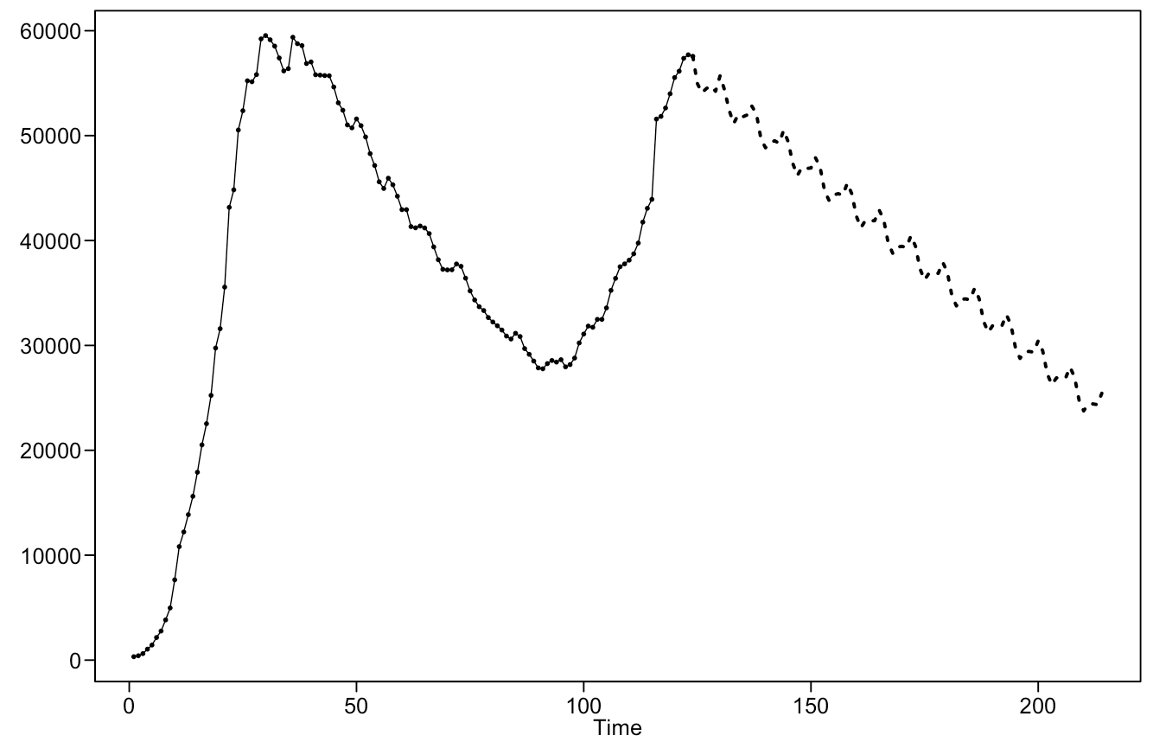
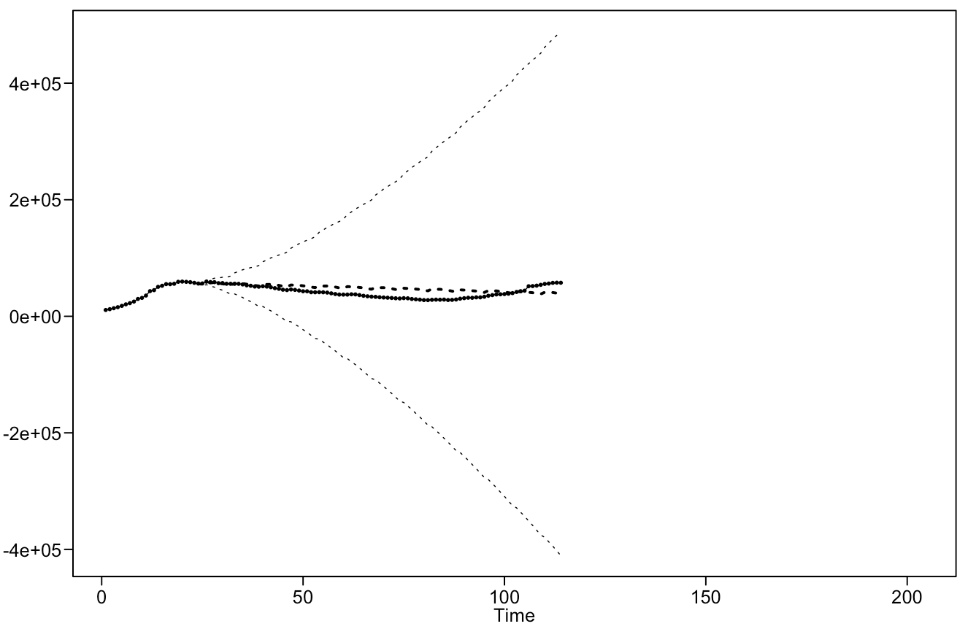
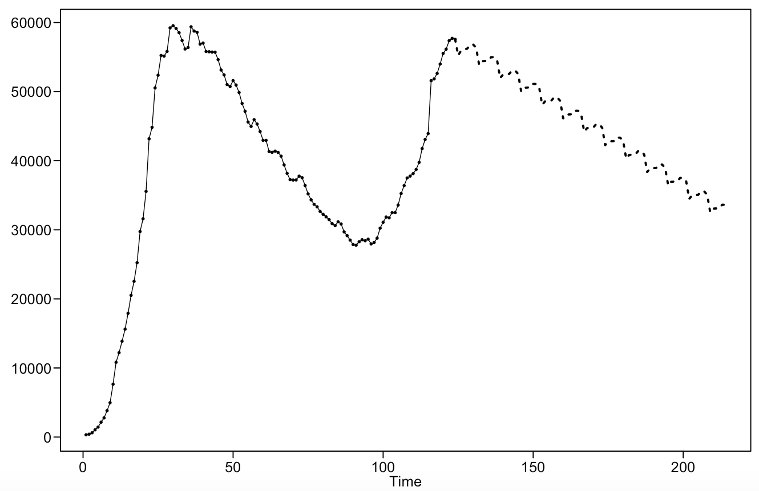
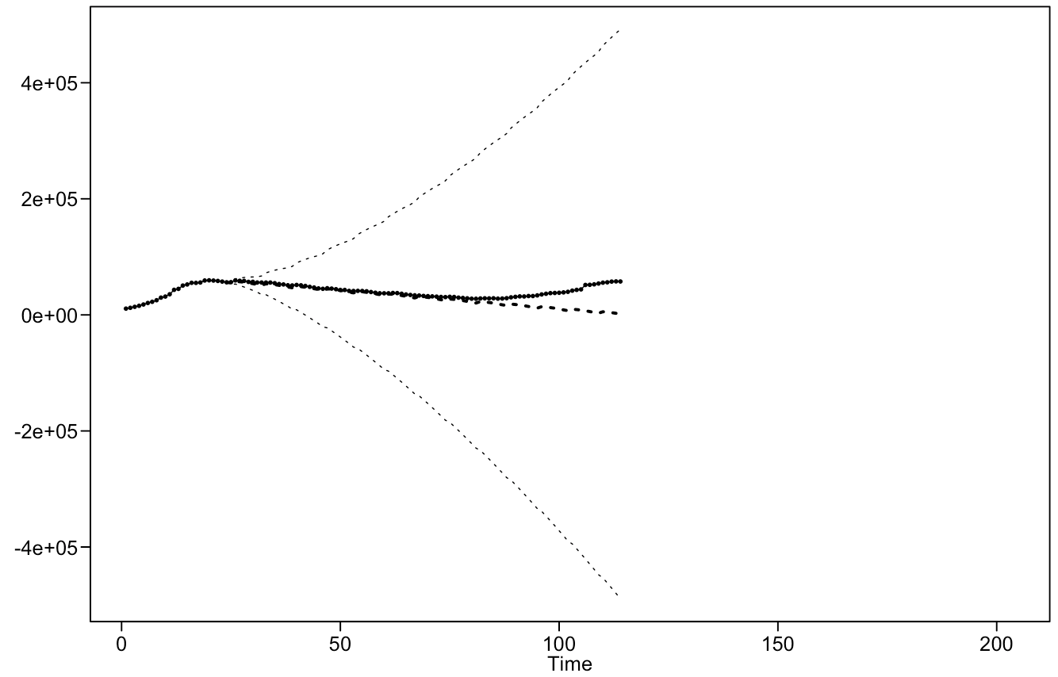
United states
90 Day Forecast
ARIMA(5, 1, 1), s = 7
Windowed ASE: 71,208,194
ARIMA(2, 1, 0), s = 7
Windowed ASE: 71,620,130
Notes:
90 Day Forecast:
Again, the 90 day forecasts for both models continue the trend with a small 7 day seasonality pattern.
And again, the ARIMA(5,1,1) model is proven more useful based on its smaller windowed ASE.

Slide 8
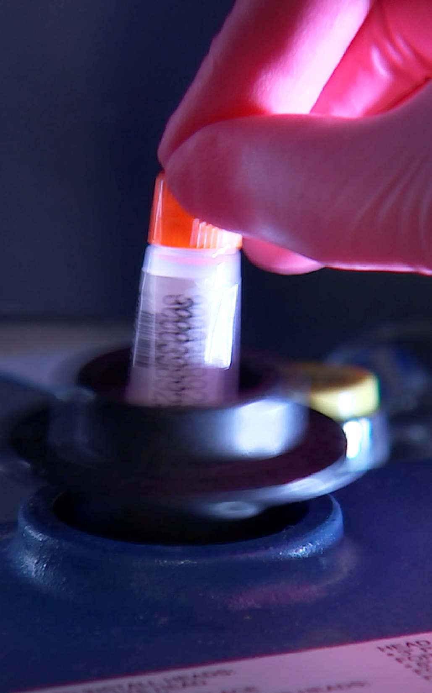
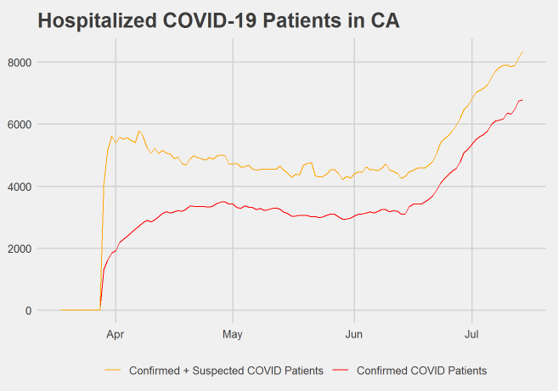
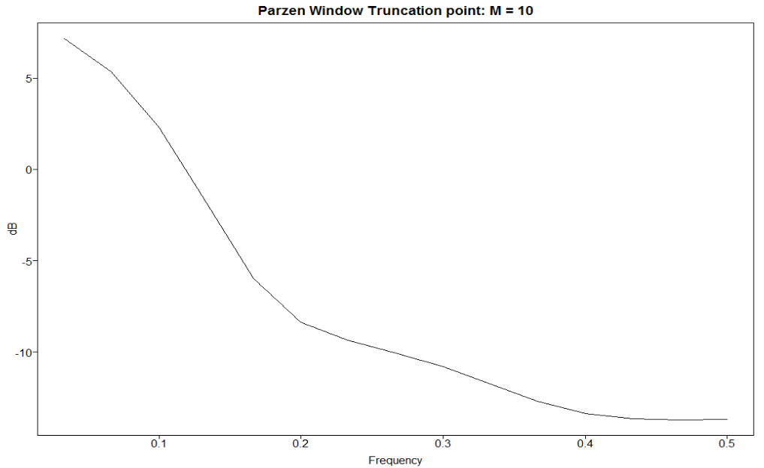
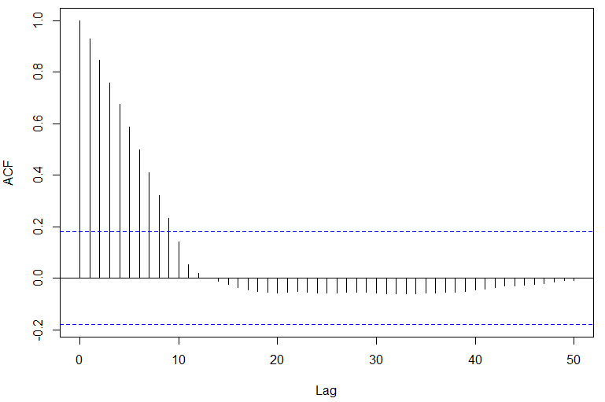
California
Non stationary
Realization
Drastically different recent behavior
Slight wandering with small decline early. Sharp incline later
ACF
quickly damping (initially)
Spectral Densities
No significant periodicity
Notes:
Josh Notes: 32 sec
For California, we used the confirmed + suspected patients to account for a large lag in getting results from early tests. This total is shown in gold, and under the same assumptions we described in the US data, we can't consider this data stationary, but we’ll show that a stationary model might still be useful.
You’ll notice the rapid increasing trend in the last month. This change in behavior might make it more prudent to model a recent subset of the data. However, like the US data, we used univariate models on the complete set to uncover any underlying behaviors that might be relevant to forecasting later.
No significant periodicity was found in the spectral density, or through the modelling process for the california data.

Slide 9

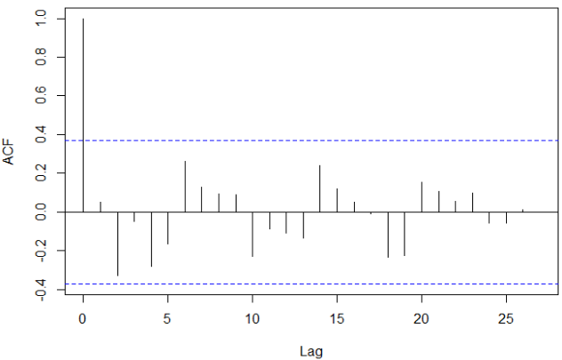
California
ARMA / ARIMA Candidate Models
Univariate Model for 90 day forecast: ARMA(1,2) vs AR(2)
Used to model based on expected eventual future decline
2 models types with lowest AIC
AIC was nearly identical, but Windowed ASE was lower for ARMA(1,2)
AR(2) ASE: 1,404,948
ARMA(1,2) ASE: 1,100,078
(1 - .977B)(X_{t}- 4722) = (1 - .009B2 - .008B)a_{t} wnv est = 151635
Univariate Model for 7 day forecast: ARIMA(0,2,0)
Modeled using only last month of data (sharp increase)
Second difference produced white noise
(1 - B)²X_{t} = a_{t}
ACF after d=2
Notes:
Josh Notes: 26 sec
A stationary model might be useful for a long term forecast because although hospitalizations are seeing a sharp increase, we expect an eventual decline, and a stationary model would force it back down toward the mean. 2 models were compared and an ARMA(1,2) was settled on for the long term model.
A better short term model would continue the current trend, since from a univariate standpoint we have little reason to believe that it’ll immediately decline.
Since differencing twice produced white noise, there were no stationary components in the ARIMA model, so no additional models were compared for the 7 day forecast.

Slide 10

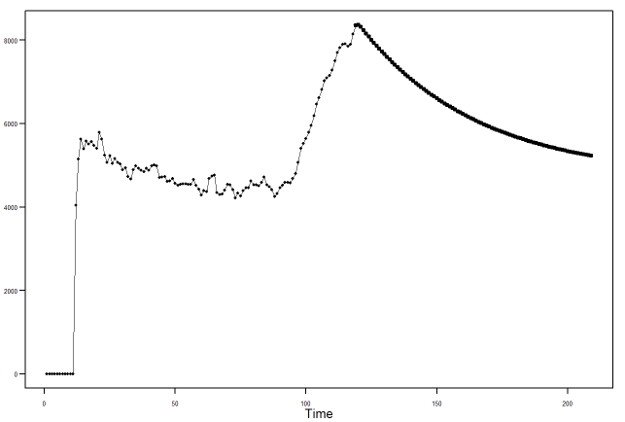
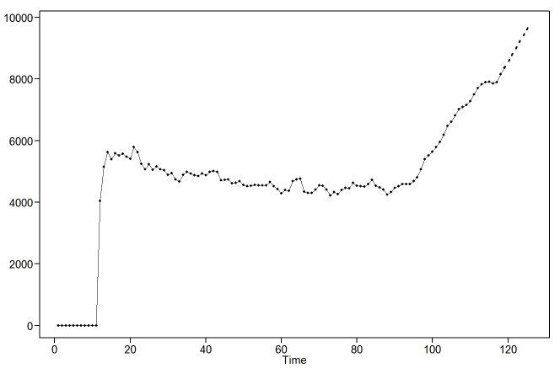
California
ARMA / ARIMA Candidate Models
Univariate Model for 90 day forecast: ARMA(2,1) vs AR(2)
Univariate Model for 7 day forecast: ARIMA(0,0,0), d=2
Notes:
Josh Notes:
Here you can see how each forecast of the two different models could be more useful depending on whether we are interested in long or short term expectations.
As with the US data, we are interested in how these models can be improved with multivariate analysis.

Slide 11

california & United States
Strategy for Improved Models
Multivariate Analysis Questions
govt policy/restrictions
Cases vs hospitalizations
other possible effects
Explore multiple modeling techniques
Multiple regression with correlated errors
VAR
MLP
Notes:
Josh
Our plan from here is to include government restrictions in multivariate models to see if they have significant effects. We think identifying variables that predict hospitalizations through other modeling techniques will be more useful than modeling against time alone, and will help us produce more informative forecasts.

Slide 12
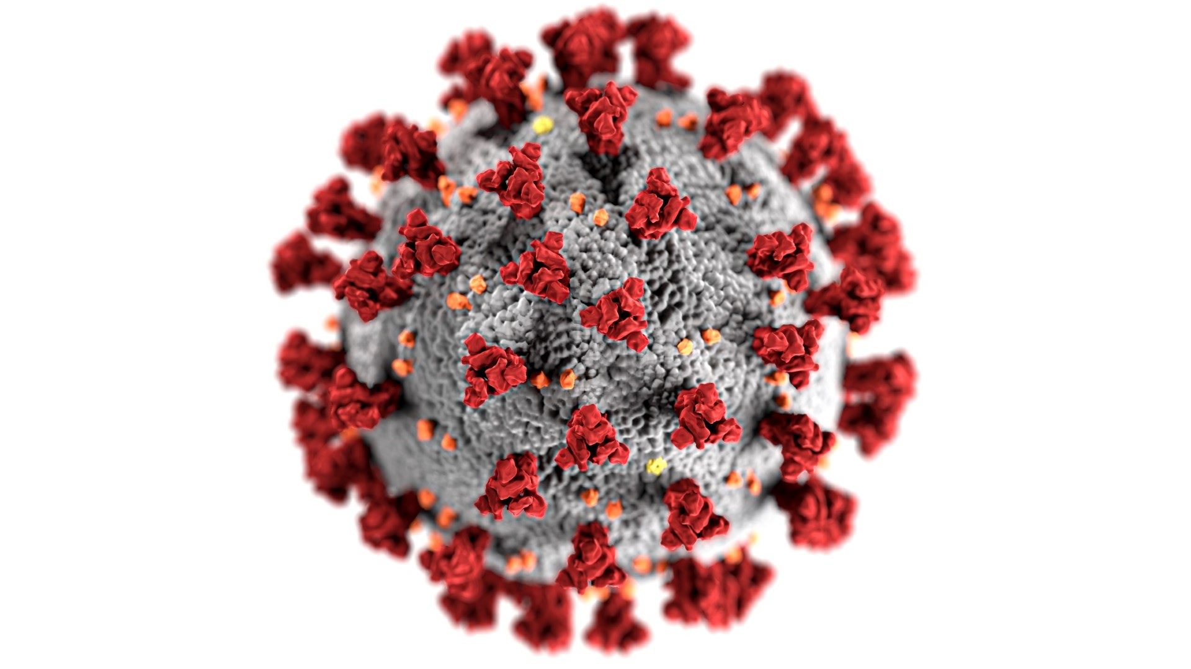
Complete codebooks can be found on our Github.
#covid19
Notes:
Jaclyn
Thank you for taking the time to review our EDA with us today.

